Slide 1
6CS005 High Performance Computing
Lecture 5 Parallel Programming

Slide 2
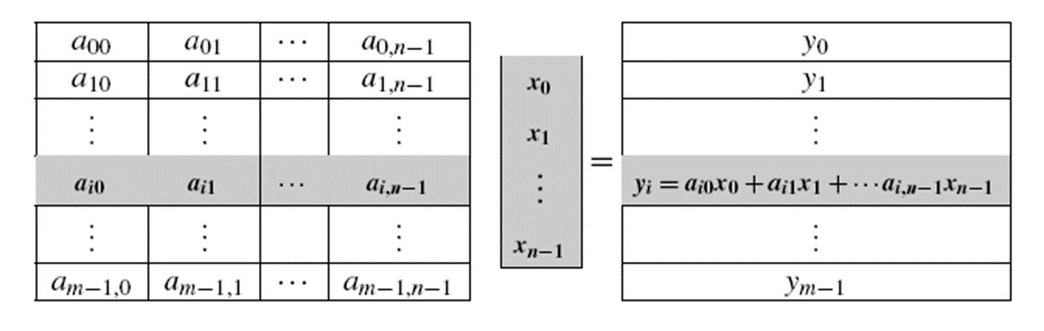
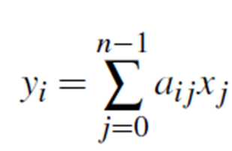
Matrix-Vector Multiplication

Slide 3
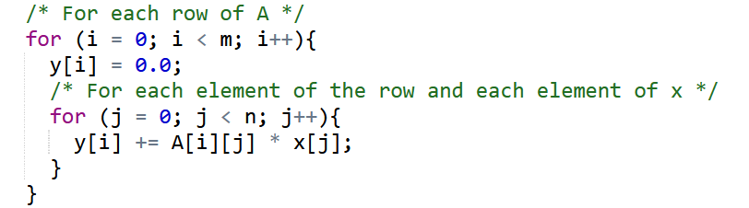
Pseudocode for serial matrix-vector multiplication
If A=(a_{ij}) is an m×n matrix and x is a vector with n components, then y=A*x is a vector with m components, and we can find the i^{th} component of y by forming the dot product of the i^{th} row of A with x:

Slide 4
Parallelization of the matrix-vector multiplication
Need parallelize this by dividing the work among the threads.
One possibility is to divide the iterations of the outer loop among the threads.
If we do this, each thread will compute some of the components of y.

Slide 5
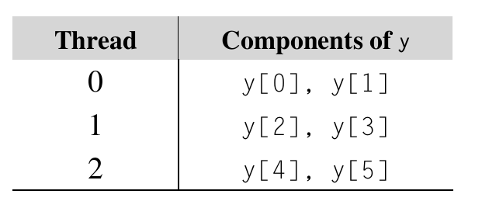
Parallelising Processing
For example, suppose that m=6 and the number of threads, thread_count or n, is three. Then the computation could be divided among the threads as follows:

Slide 6
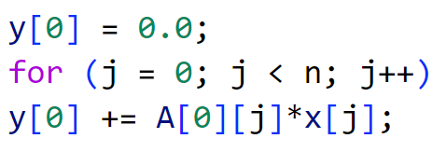
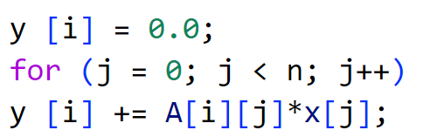
Contd…
To compute y[0], thread 0 will need to execute the code
Therefore thread 0 will need to access every element of row 0 of A and every element of x.
More generally, the thread that has been assigned y[i] will need to execute the code

Slide 7
Parallelising Processing
Thus for n threads, and m rows:
  Thread 0
    start row = 0
    end row = (m/n) -1
  Thread 1
    start row = (m/n)
    end row = (m/n) + (m/n) -1
  Thread 2
    start row = (m/n) + (m/n)
    end row = (m/n) + (m/n) + (m/n) -1
  Thread 3
    start row = (m/n) + (m/n) + (m/n)
    end row = (m/n) + (m/n) + (m/n) + (m/n) -1
    …
    …
  Thread k
    start row = k * (m/n)
    end row = ((k + 1) * (m/n)) -1 /* the very last end row need to be adjusted if m is not a multiple of n */

Slide 8
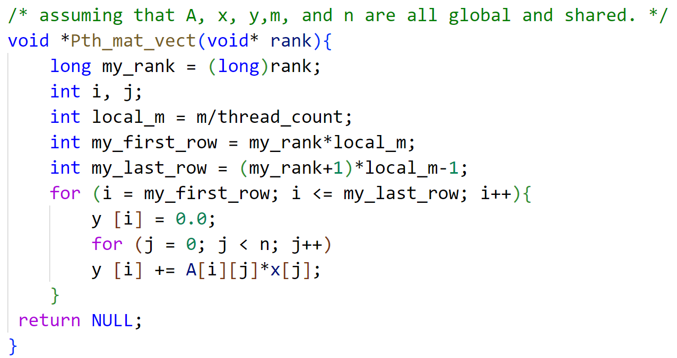
Pthread Function for matrix-vector multiplication

Slide 9
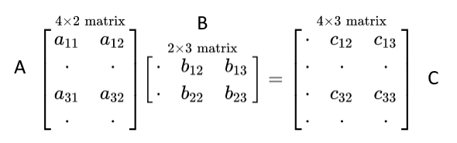
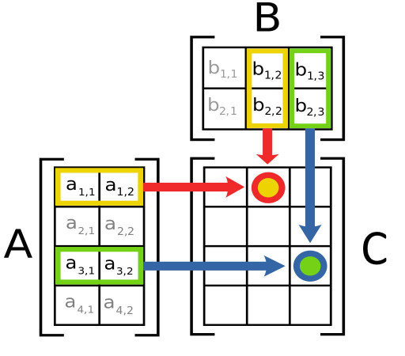

4x2 and 2x3 Matrix-Matrix Multiplication

Slide 10
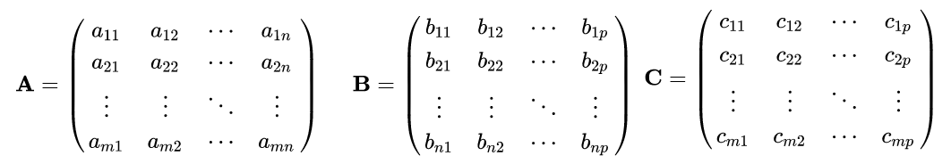
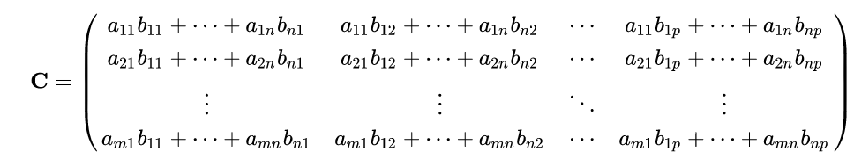

General Matrix-Matrix Multiplication

Slide 11
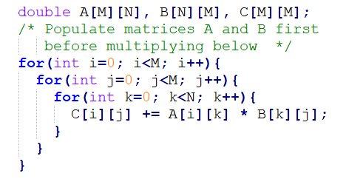
Pseudocode for General Matrix-Matrix Multiplication of A x B = C

Slide 12
Race Condition
A race condition arises in software when a computer program, to operate properly, depends on the sequence or timing of the program's processes or threads.
Critical race conditions often happen when the processes or threads depend on some shared state.

Slide 13
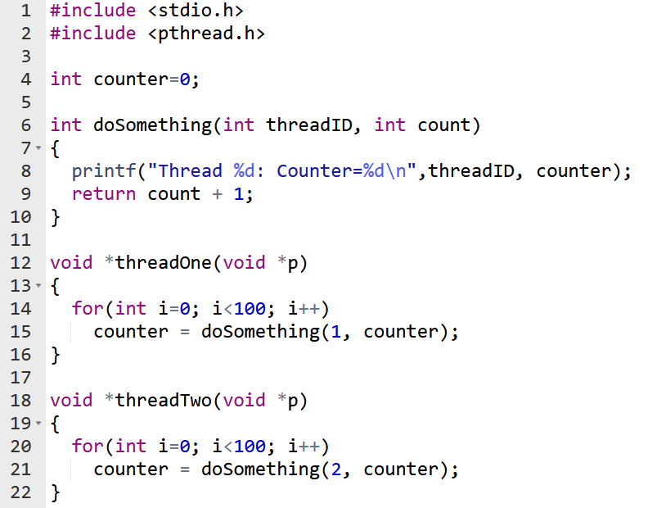
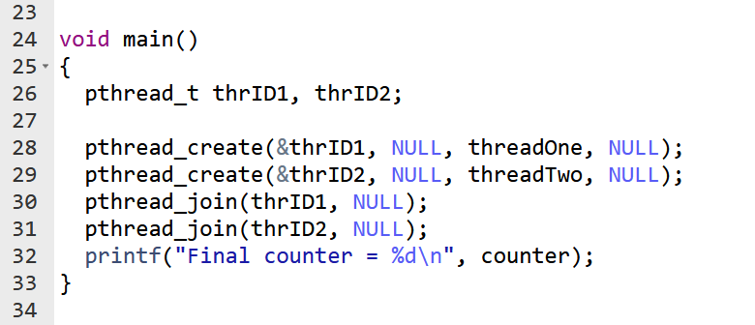
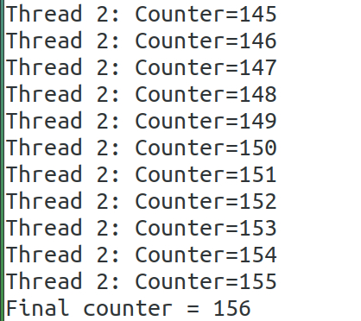
Race Condtion
Critical Sections

Slide 14
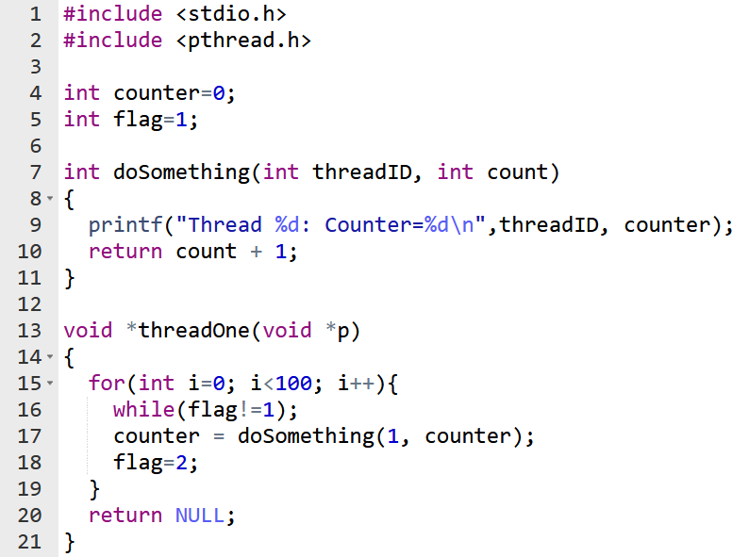
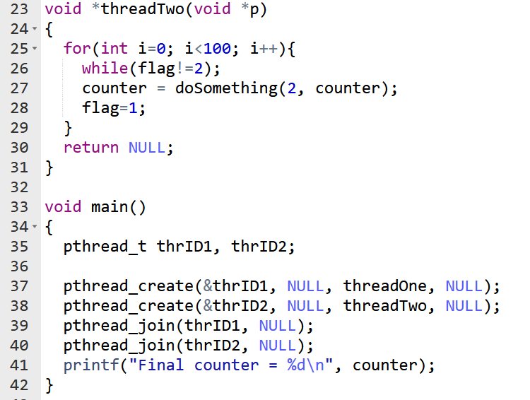
Busy Wait
Busy Wait

Slide 15
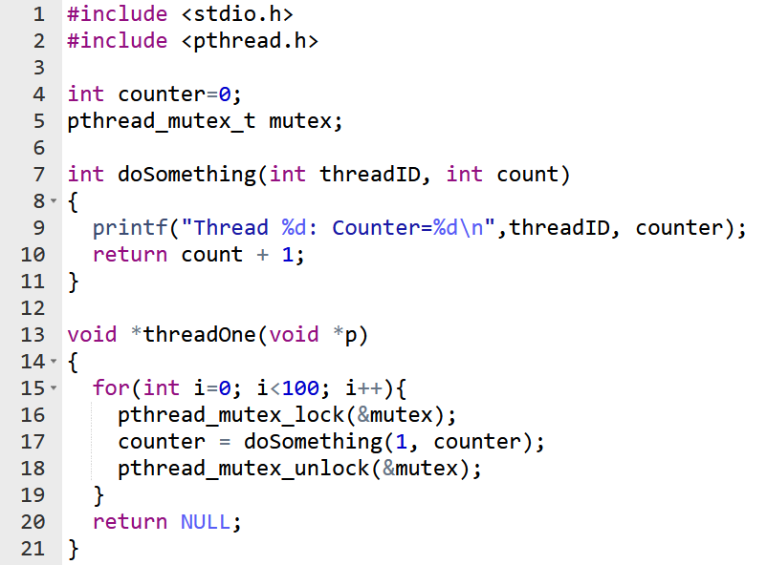
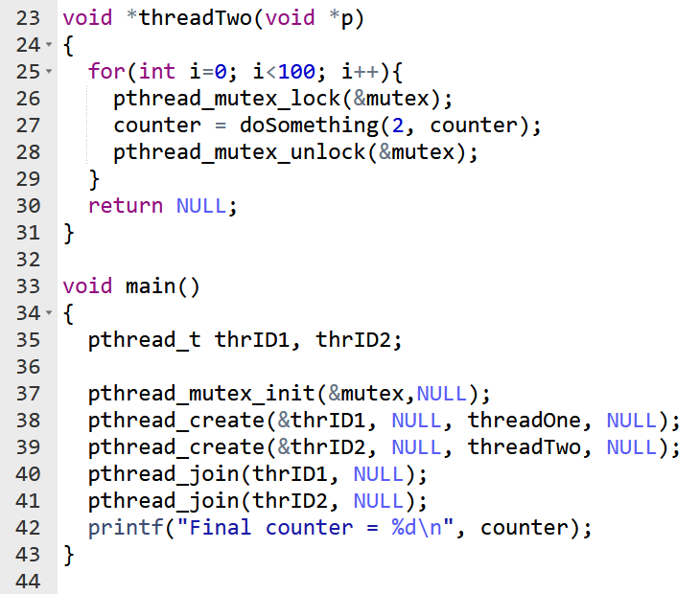
Mutex

Slide 16
Issues
Since a thread that is busy-waiting may continually use the CPU, busy-waiting is generally not an ideal solution to the problem of limiting access to a critical section.
Two better solutions are mutexes and semaphores.
Mutex is an abbreviation of mutual exclusion, and a mutex is a special type of variable that, together with a couple of special functions, can be used to restrict access to a critical section to a single thread at a time.
Thus a mutex can be used to guarantee that one thread “excludes” all other threads while it executes the critical section.
Hence, the mutex guarantees mutually exclusive access to the critical section.

Slide 17
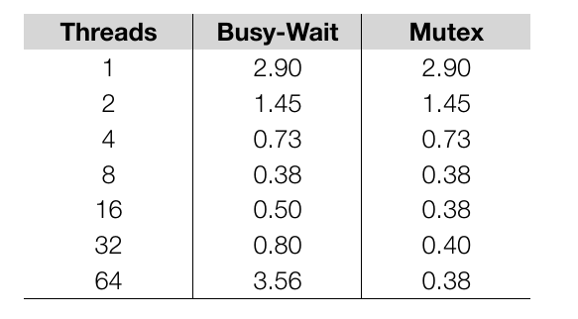
Fig: Run-times(in seconds) of Pi programs using n=10⁸ term on system with two four-core processor

Slide 18
Barriers and Condition Variables

Slide 19
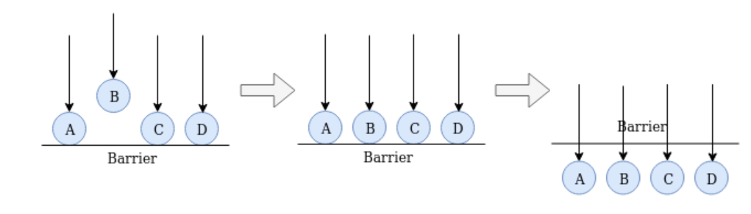
Barriers
In shared-memory programming: synchronizing the threads by making sure that they all are at the same point in a program.
Such a point of synchronization is called a barrier, because no thread can proceed beyond the barrier until all the threads have reached it.

Slide 20
Busy-waiting and a Mutex
Implementing a barrier using busy-waiting and a mutex is straightforward: we use a shared counter protected by the mutex.
When the counter indicates that every thread has entered the critical section, threads can leave the busy-wait loop.

Slide 21
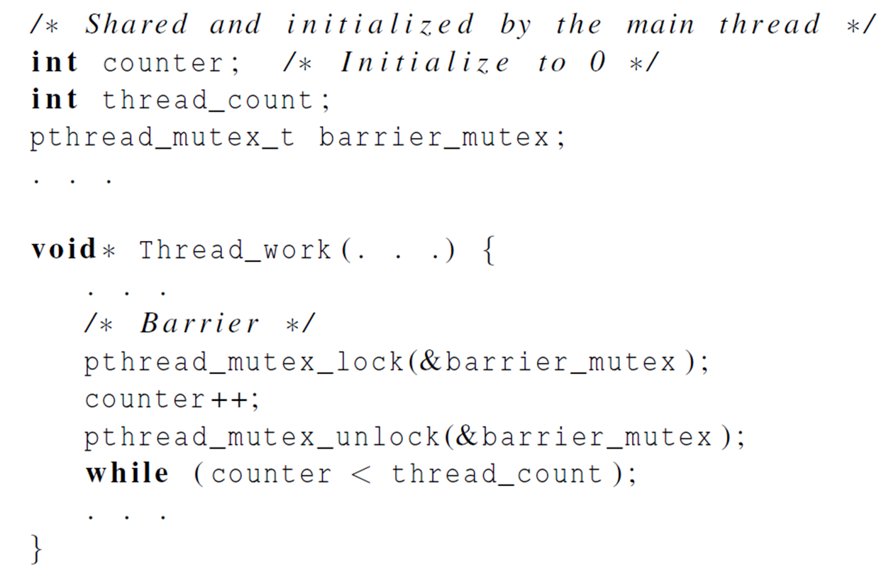
Busy-waiting and a Mutex

Slide 22
Problems in Busy-Waiting and Mutex Implementation
First barrier
  Threads use a busy-wait loop (while(counter < thread_count)) to wait for all threads to reach the barrier, threads consume CPU cycles while waiting
Second barrier
  Reusing the same counter variable causes unsynchronized behavior.
  At the start of the second barrier, counter = thread_count from the first barrier, making the condition counter < thread_count immediately false.
  As a result, threads bypass the second barrier, leading to unsynchronized execution.

Slide 23
Contd…
Resetting the counter after first barrier
  After all threads exit the first barrier but before they reach the second barrier.
  Increments to counter may be lost, making the second barrier condition unreachable (counter < thread_count fails to meet).
  This causes deadlock as threads hang in the busy-wait loop of the second barrier.

Slide 24
Solution???
To resolve this issues:
  Use Separate Counters:
  Allocate independent counters for each barrier instance to avoid conflicts.
  Use Condition Variables(pthread_cond_wait):
  Replace the busy-waiting loop with condition variables to manage thread synchronization efficiently and avoid race conditions (Threads block until signaled, avoiding CPU waste.)

Slide 25
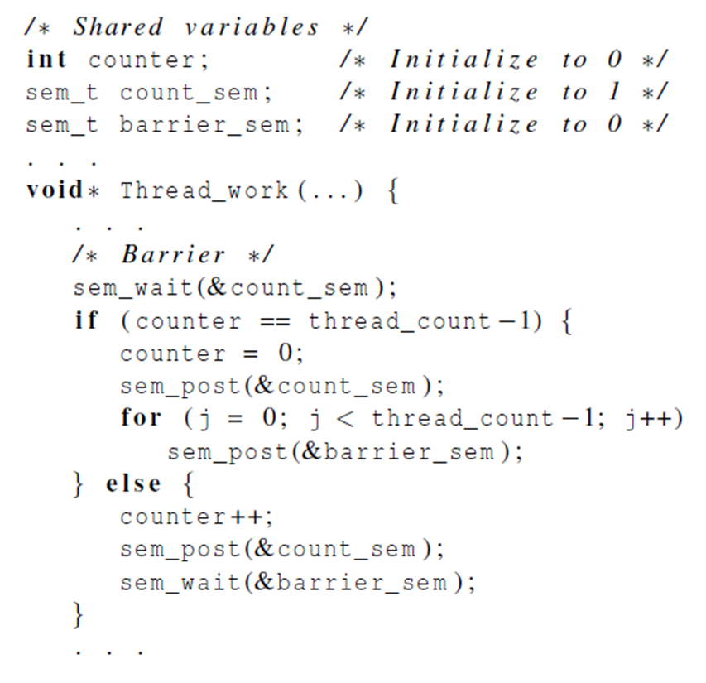
Implementing a barrier with semaphores

Slide 26
Contd…
count_sem: Protects the counter and ensures mutual exclusion during its modification.
barrier_sem: Blocks threads at the barrier until all threads have arrived.
Threads increment the counter under protection by count_sem.
The last thread resets the counter and releases all waiting threads by calling sem_post(&barrier_sem) multiple times.
Semaphores prevent busy-waiting, conserving CPU resources.

Slide 27
Contd…
counter and count_sem can be reused since they are properly reset before threads exit the barrier.
Reusing barrier_sem can lead to a race condition if threads proceed to the next barrier before all threads have finished decrementing barrier_sem in the first barrier.

Slide 28
Solution???
Separate barrier_sem for Each Barrier:
  Allocate a unique barrier_sem for each barrier to prevent interference between barriers.
  Ensure threads only interact with the barrier_sem specific to their current barrier.
Synchronization Between Barriers:
  Ensure threads cannot proceed to the next barrier until all threads have exited the first barrier.
  Use additional synchronization mechanisms (e.g., flags or condition variables) to guarantee proper sequencing.

Slide 29
Condition Variables
A somewhat better approach to creating a barrier in Pthreads is provided by condition variables.
A condition variable is a data object that allows a thread to suspend execution until a certain event or condition occurs.
When the event or condition occurs another thread can signal the thread to “wake up.”
A condition variable is always associated with a mutex.

Slide 30
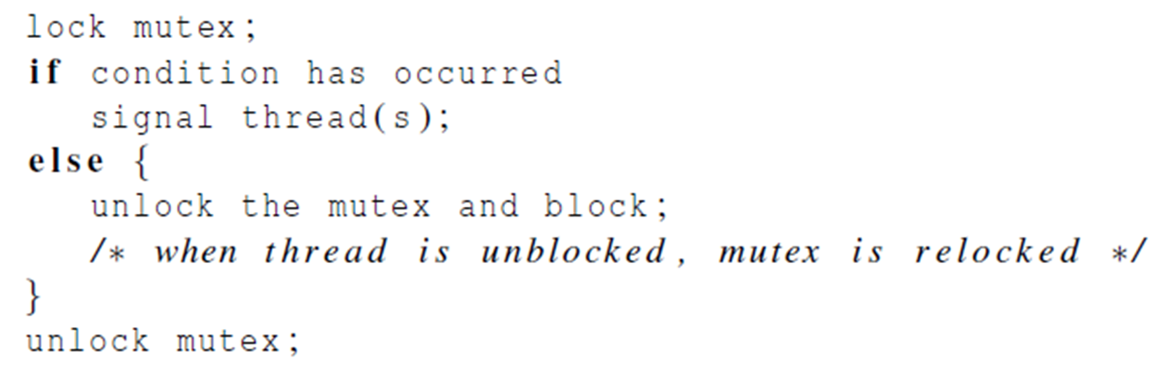
Condition Variables
Typically, condition variables are used in constructs similar to this pseudocode:

Slide 31
Contd…
Lock mutex ensures exclusive access to shared resources.
If the condition has occurred, the thread notifies other threads that are waiting on this condition variable using pthread_cond_signal or pthread_cond_broadcast
The function
int pthread_cond_signal( pthread_cond_t∗ cond_var_p); will unblock one of the blocked threads, and
int pthread_cond_broadcast( pthread_cond_t∗ cond_var_p); will unblock all of the blocked threads.

Slide 32
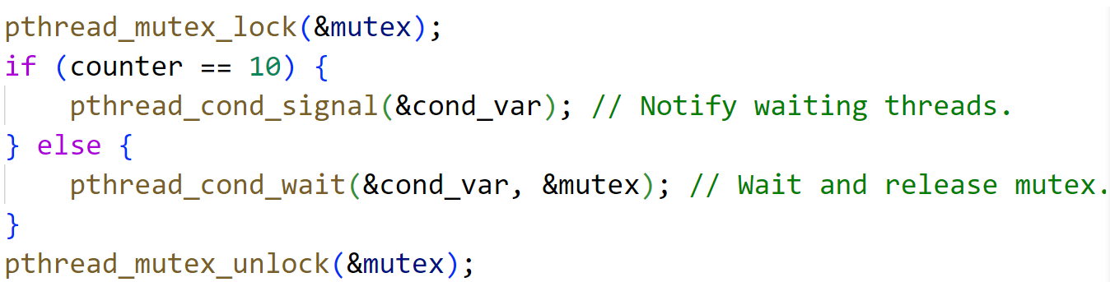
Contd…
If not, the thread waits and releases the mutex, allowing other threads to update the counter.

Slide 33
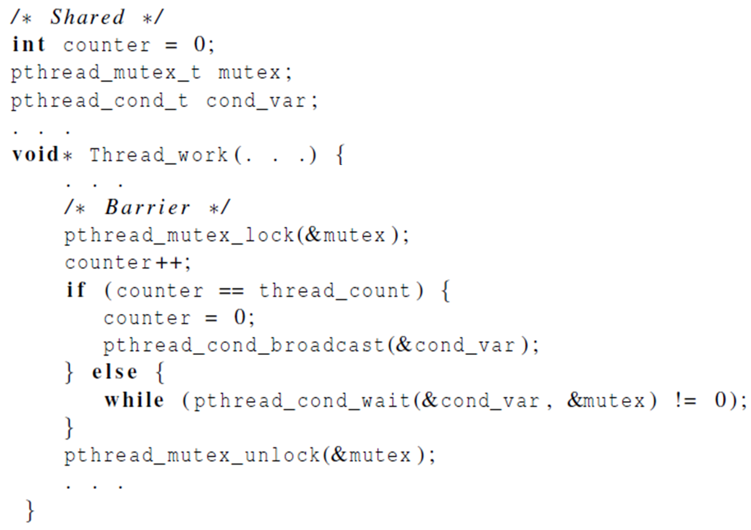
Implementing a barrier with condition variables

Slide 34
Contd…
Int counter: Tracks the number of threads that have reached the barrier.
pthread_mutex_t mutex: Protects access to the shared counter to prevent race conditions.
pthread_cond_t cond_var: Used for condition-based synchronization (to block and wake threads).
pthread_mutex_lock(&mutex) locks the mutex to protect shared data.
The counter is incremented by the thread to indicate it has reached the barrier.
If the counter equals thread_count, it means all threads have reached the barrier. The thread resets the counter to 0.It then broadcasts a signal using pthread_cond_broadcast(&cond_var) to wake all threads waiting at the barrier.
If the thread is not the last to reach the barrier, it waits on the condition variable with pthread_cond_wait(&cond_var, &mutex).

Slide 35
Pthreads Read-Write Locks
Pthreads read-write locks, a synchronization mechanism used to allow multiple threads to access a shared resource with different levels of concurrency.
Mutex vs. Read-Write Locks:
  A mutex allows only one thread to access a resource at any given time.
  Read-write locks provide more flexibility by allowing multiple threads to read the resource concurrently but ensuring exclusive access for one thread when writing.

Slide 36
How Read-Write Locks Work?
Read Lock (pthread_rwlock_rdlock):
  Allows multiple threads to simultaneously read the resource.
  If any thread holds a read lock, other threads can also acquire the read lock.
Write Lock (pthread_rwlock_wrlock):
  Only one thread can hold a write lock at a time.
  If a thread holds the write lock, no other threads can acquire either a read or a write lock.
Unlock (pthread_rwlock_unlock):
  Used to release the read or write lock after the thread finishes its operations on the shared resource.

Slide 37
Pthreads Read-Write Locks Functions
int pthread_rwlock_rdlock(pthread_rwlock_t *rwlock_p);
int pthread_rwlock_tryrdlock(pthread_rwlock_t *rwlock_p);
int pthread_rwlock_wrlock(pthread_rwlock_t *rwlock_p);
int pthread_rwlock_trywrlock(pthread_rwlock_t *rwlock_p);
int pthread_rwlock_unlock(pthread_rwlock_t *rwlock_p);
int pthread_rwlock_init(pthread_rwlock_t *rwlock_p,
const pthread_rwlockattr_t *attr_p);
int pthread_rwlock_destroy(pthread_rwlock_t *rwlock_p);

Slide 38
Thread-Safety
In shared-memory programming, thread safety refers to the ability of a block of code to be executed by multiple threads simultaneously without causing issues, such as data corruption or incorrect results.
Example
  Suppose we want to use multiple threads to “tokenize” a file that consists of ordinary English text.
  The tokens are just contiguous sequences of characters separated from the rest of the text by white-space — a space, a tab, or a newline.

Slide 39
Simple approach
Divide the input file into lines of text and assign the lines to the threads in a round-robin fashion.
The first line goes to thread 0, the second goes to thread 1,…, the nth goes to thread n, the n +1st goes to thread 0, etc.
We can serialize access to the lines of input using semaphores.
After a thread has read a single line of input, it can tokenize the line using the C standard library "strtok()" function.

Slide 40
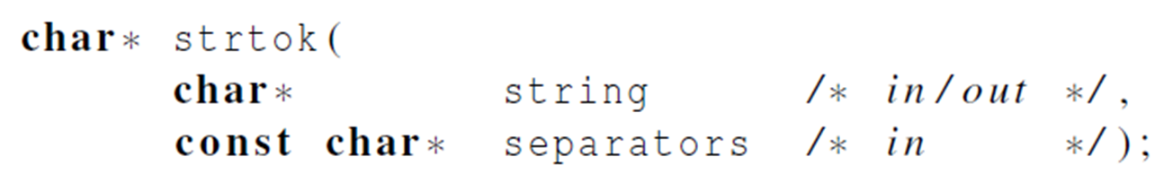
The strtok() function
The first time it’s called the string argument should be the text to be tokenized.
For subsequent calls, the first argument should be NULL.
The idea is that in the first call, strtok caches a pointer to string, and for subsequent calls it returns successive tokens taken from the cached copy.

Slide 41
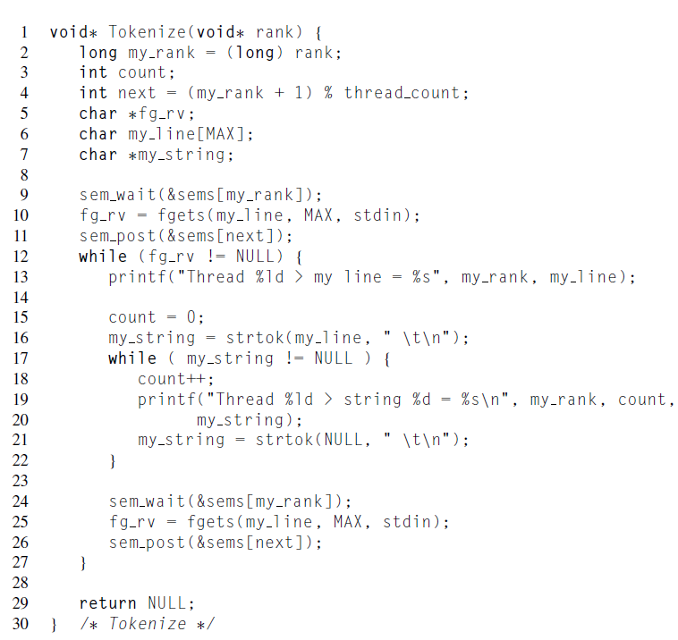

Slide 42
Running with one thread
It correctly tokenizes the input stream.
  Pease porridge hot.
  Pease porridge cold.
  Pease porridge in the pot
  Nine days old.

Slide 43
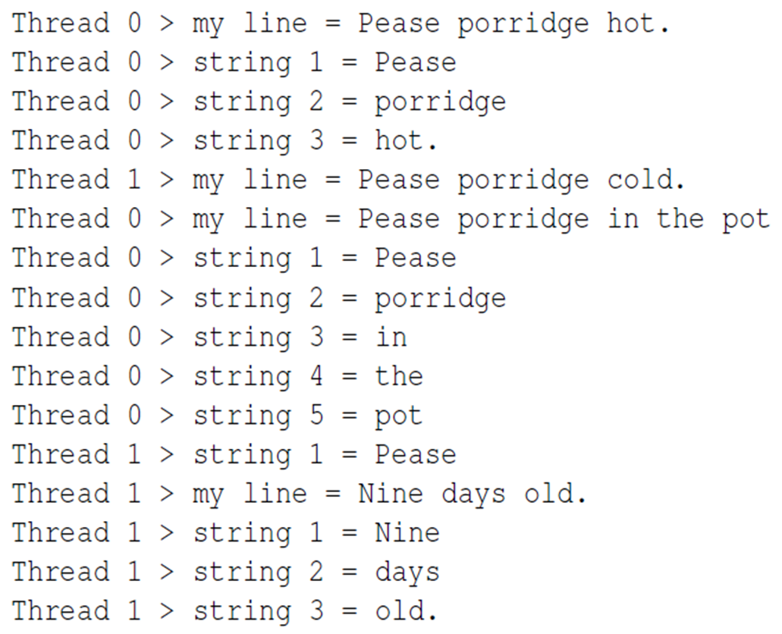
Running with two threads

Slide 44
What happened?
strtok() caches the input line by declaring a variable to have static storage class.
This causes the value stored in this variable to persist from one call to the next.
Unfortunately for us, this cached string is a global.
Thus, thread 0’s call to strtok() with the third line of the input has apparently overwritten the contents of thread 1’s call with the second line.
So the strtok() function is not thread-safe.
If multiple threads call it simultaneously, the output may not be correct.

Slide 45
Other unsafe C library functions
It’s not uncommon for C library functions to not be thread-safe.
The random number generator random in stdlib.h.
The time conversion function localtime in time.h.

Slide 46
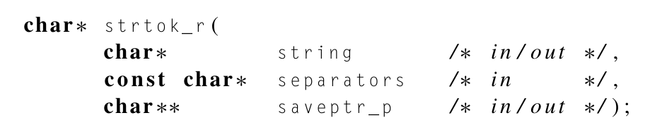
Solution??
To resolve this issue, use a thread-safe version of strtok, such as strtok_r (reentrant strtok), which allows each thread to maintain its own internal state during tokenization.
Each thread would pass its own saveptr to strtok_r, allowing them to tokenize independently without affecting each other.

Slide 47
Summary
A thread in shared-memory programming is analogous to a process in distributed memory programming.
However, a thread is often lighter-weight than a full-fledged process.
In Pthreads programs, all the threads have access to global variables, while local variables usually are private to the thread running the function.
When indeterminate results arise from multiple threads attempting to access a shared resource such as a shared variable or a shared file, at least one of the accesses is an update, and the accesses can result in an error, we have a race condition.

Slide 48
Summary
A critical section is a block of code that updates a shared resource that can only be updated by one thread at a time.
So the execution of code in a critical section should, effectively, be executed as serial code.
Busy-waiting can be used to avoid conflicting access to critical sections with a flag variable and a while-loop with an empty body.
It can be very wasteful of CPU cycles.
It can also be unreliable if compiler optimization is turned on.

Slide 49
Summary
A mutex can be used to avoid conflicting access to critical sections as well.
Think of it as a lock on a critical section, since mutexes arrange for mutually exclusive access to a critical section.
A semaphore is the third way to avoid conflicting access to critical sections.
It is an unsigned int together with two operations: sem_wait and sem_post.
Semaphores are more powerful than mutexes since they can be initialized to any nonnegative value.

Slide 50
Summary
A barrier is a point in a program at which the threads block until all of the threads have reached it.
A read-write lock is used when it’s safe for multiple threads to simultaneously read a data structure, but if a thread needs to modify or write to the data structure, then only that thread can access the data structure during the modification.
Some C functions cache data between calls by declaring variables to be static, causing errors when multiple threads call the function.
This type of function is not thread-safe.

Slide 51
End of Lecture 5

